Slide 1
This slide is hidden.
Insert the starting slides after this slide
Notes:
<number>

Slide 2
This slide is hidden.
Insert the Entrance Hymn after this slide
Notes:
<number>

Slide 3
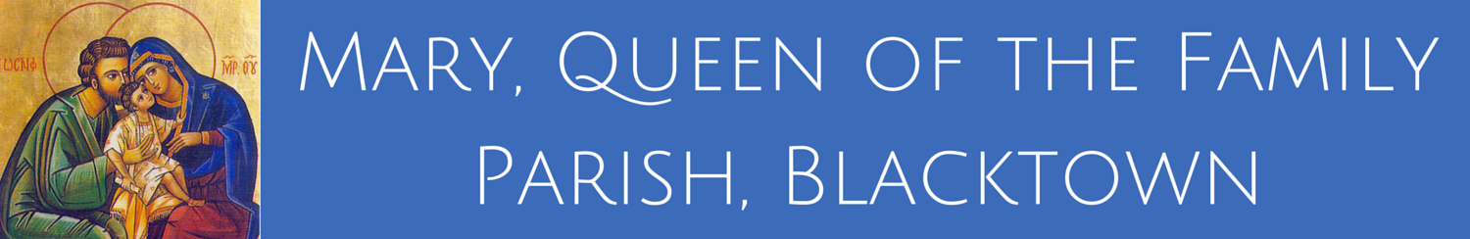
Mary, Queen of the Family Parish
is a welcoming, diverse, multicultural, Catholic community.
We seek to live, teach and share the joy of the Gospel; to grow as disciples of Jesus through prayer, witness and action and to respond to the needs of the family in the Blacktown community and beyond.
Notes:
<number>
Saturday 5.30PM First Sunday of Advent
28th Sunday in Ordinary Time - Year C
Sunday, 09 October 2016

Slide 4
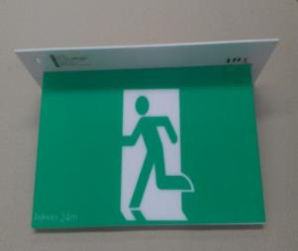
SAFETY MESSAGE
Please take a moment to
identify your closest exit.
There will be an announcement if we need to evacuate the building.
Evacuate the building via the nearest Exit & proceed directly to the footpath along Orwell Street.
DO NOT move any vehicles or remain in the car park.
Notes:
St Michael’s Safety Message
28th Sunday in Ordinary Time - Year C
Sunday, 09 October 2016

Slide 5

Welcome to our Parish
Second Sunday in Ordinary Time
Year A
You have entered a SACRED SPACE ... A SACRED TIME
Please ensure all mobile phones are switched off.
Please be respectfully quiet at this time.
Notes:
<number>
Saturday 5.30PM First Sunday of Advent
28th Sunday in Ordinary Time - Year C
Sunday, 09 October 2016

Slide 6
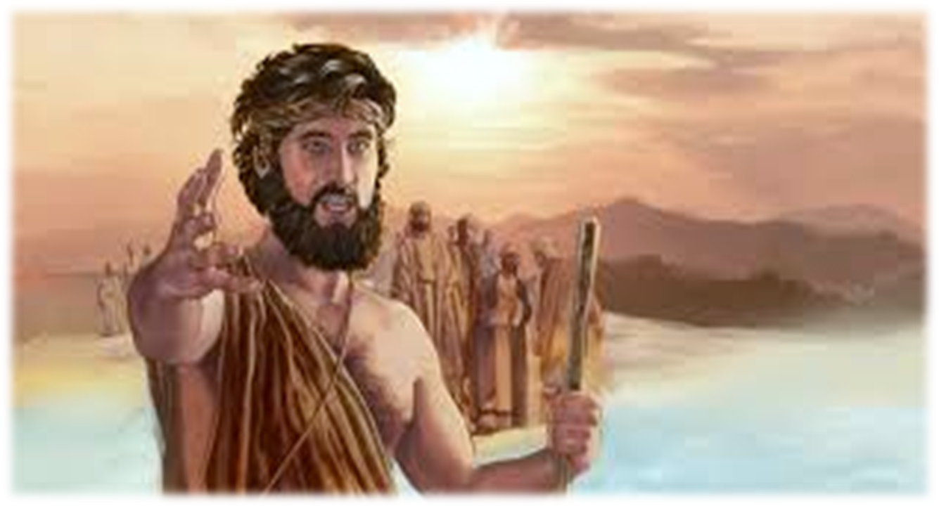
Seeing Jesus coming towards him, John said, ‘Look, there is the lamb of God
Notes:
28th Sunday in Ordinary Time - Year C
Sunday, 09 October 2016

Slide 7
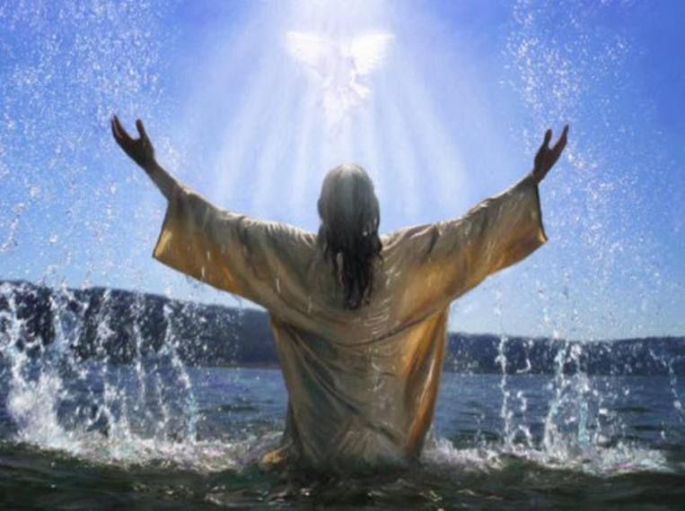
‘I saw the Spirit coming down on him from heaven like a dove and resting on him.
Notes:
28th Sunday in Ordinary Time - Year C
Sunday, 09 October 2016

Slide 8
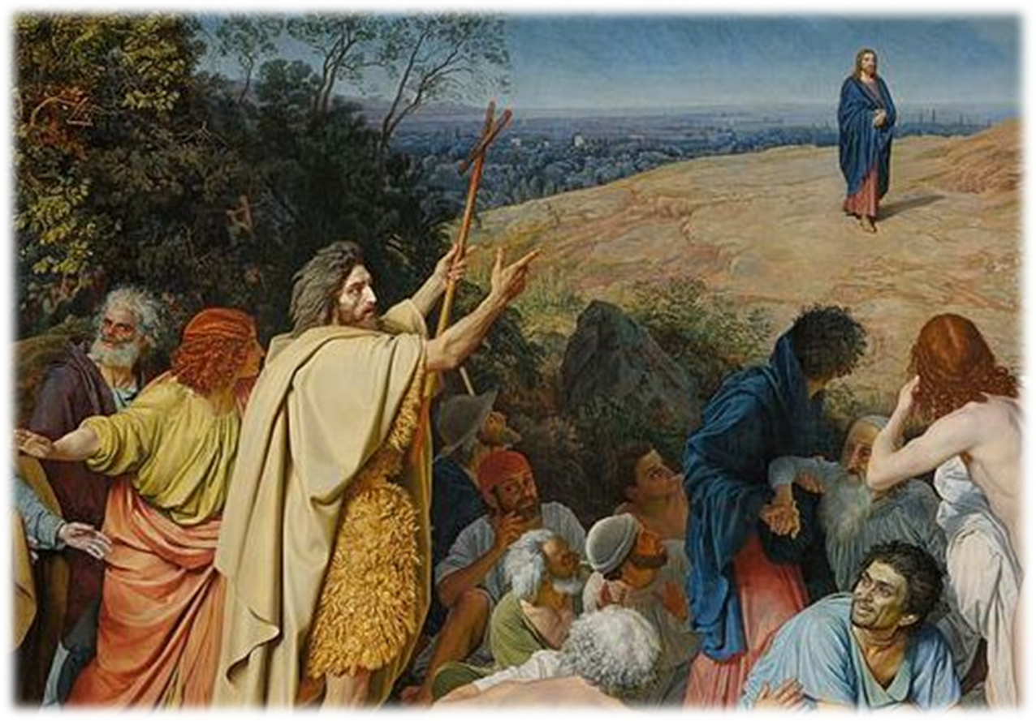
Yes, I have seen and I am the witness
… he is the Chosen One of God.’
Notes:
28th Sunday in Ordinary Time - Year C
Sunday, 09 October 2016

Slide 9
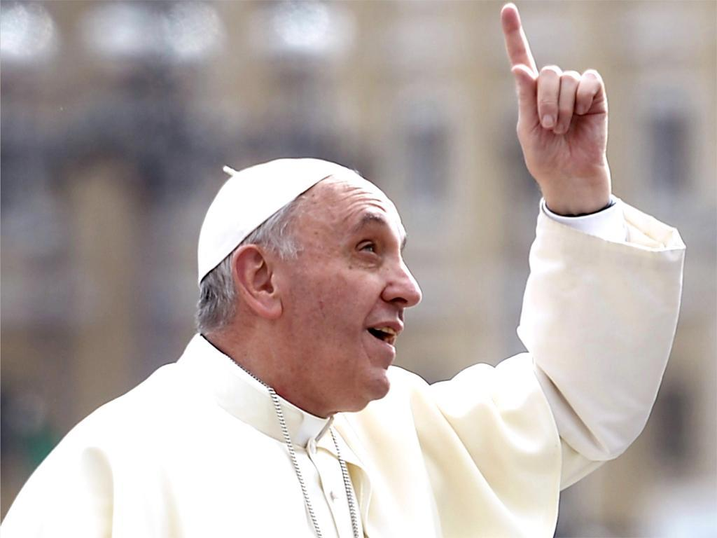
We are called to be a living witness
to Christ in all that we do.
How will you point to God in your everyday experiences this week?
Notes:
28th Sunday in Ordinary Time - Year C
Sunday, 09 October 2016

Slide 10
Please stand
Notes:
<number>

Slide 11
City of God (Dan Schutte)
Awake from your slumber
Arise from your sleep
A new day is dawning
For all those who weep

Slide 12
The people in darkness
Have seen a great light
The Lord of our longing
Has conquered the night

Slide 13
Let us build the city of God.
May our tears be turned into dancing!
For the Lord, our light and our love,
has turned the night into day!

Slide 14
We are sons of the morning
We are daughters of day.
The One who has loved us
Has brightened our way.

Slide 15
The Lord of all kindness
Has called us to be
A light for his people
To set their hearts free.

Slide 16
Let us build the city of God.
May our tears be turned into dancing!
For the Lord, our light and our love,
has turned the night into day!
“City of God” Words & music by Dan Schutte
© 1981 New Dawn Music
Used by Permission. CCLI License #89350

Slide 17
Notes:
<number>

Slide 18
Confiteor
I confess to almighty God
And to you, my brothers and sisters,
That I have greatly sinned
In my thoughts and in my words
Notes:
<number>

Slide 19
In what I have done
And in what I have failed to do,
Through my fault,
Through my fault,
Through my most grievous fault;
Notes:
<number>

Slide 20
Therefore I ask blessed Mary ever-Virgin,
All the Angels and Saints,
And you, my brothers and sisters,
To pray for me to the Lord our God.
The English translation of The Roman Missal © 2010,
International Commission on English in the Liturgy Corporation.
All rights reserved.
Notes:
<number>

Slide 21
Notes:
<number>

Slide 22
Penitential act
Kyrie eleison: Kyrie eleison
Christe eleison: Christe eleison
Kyrie eleison: Kyrie eleison
The English translation of The Roman Missal © 2010,
International Commission on English in the Liturgy Corporation.
All rights reserved.
Notes:
<number>

Slide 23
Gloria
Glory to God in the highest,
and on earth peace to people of good will.
We praise you, we bless you,
we adore you, we glorify you,
Notes:
<number>

Slide 24
We give you thanks for your great glory,
Lord, God heavenly king,
O God, almighty father
Notes:
<number>

Slide 25
Glory to God in the highest,
and on earth peace to people of good will.
Notes:
<number>

Slide 26
Lord Jesus Christ, Only Begotten Son,
Lord God, Lamb of God, Son of the Father,
you take away the sins of the world,
have mercy on us;
Notes:
<number>

Slide 27
you take away the sins of the world, receive our prayer;
you are seated at the right hand of the Father,
have mercy on us.
Notes:
<number>

Slide 28
Glory to God in the highest,
and on earth peace to people of good will.
Notes:
<number>

Slide 29
For you alone are the Holy One,
you alone are the Lord,
you alone are the Most High, Jesus Christ,
with the Holy Spirit,
in the glory of God the Father.
Notes:
<number>

Slide 30
Glory to God in the highest,
and on earth peace to people of good will.
Amen.
The English translation of The Roman Missal © 2010,
International Commission on English in the Liturgy Corporation. All rights reserved.
Notes:
<number>

Slide 31
Notes:
<number>

Slide 32

Responsorial Psalm
Here I am, Lord;
I come to do your will.
Notes:
<number>

Slide 33
I waited, I waited for the Lord and he stooped down to me; he heard my cry. He put a new song into my mouth, praise of our God.
Here I am, Lord;
I come to do your will.

Slide 34
You do not ask for sacrifice and offerings, but an open ear. You do not ask for holocaust and victim. Instead, here am I.
Here I am, Lord;
I come to do your will.

Slide 35
In the scroll of the book it stands written that I should do your will. My God, I delight in your law in the depth of my heart.
Here I am, Lord;
I come to do your will.

Slide 36
Your justice I have proclaimed in the great assembly. My lips I have not sealed; you know it, O Lord.
Here I am, Lord;
I come to do your will.

Slide 37
Notes:
<number>

Slide 38
Alleluia
Alleluia, alleluia
Alleluia, alleluia.
Notes:
<number>

Slide 39
The Word of God became flesh and dwelt among us.
He enabled those who accepted him
to become the children of God.

Slide 40
Alleluia, alleluia
Alleluia, alleluia
Notes:
<number>

Slide 42
Apostles Creed
I believe in God,
the Father almighty,
Creator of heaven and earth,
and in Jesus Christ, his only Son, our Lord,
Notes:
<number>

Slide 43
(At the words that follow, up to and including the Virgin Mary, all bow.)
who was conceived by the Holy Spirit,
born of the Virgin Mary,
suffered under Pontius Pilate,
was crucified, died and was buried;
he descended into hell;
Notes:
<number>

Slide 44
on the third day he rose again from the dead;
he ascended into heaven,
and is seated at the right hand of God the Father almighty;
Notes:
<number>

Slide 45
from there he will come to judge the living and the dead.
I believe in the Holy Spirit,
the holy catholic Church,
Notes:
<number>

Slide 46
the communion of saints,
the forgiveness of sins,
the resurrection of the body,
and life everlasting.
Amen.
The English translation of The Roman Missal © 2010,
International Commission on English in the Liturgy Corporation.
All rights reserved.
Notes:
<number>

Slide 47
Notes:
<number>

Slide 48

First Collection
This collection goes to the Bishop
for the support of the Diocese.
Thank you for your contribution
Notes:
<number>

Slide 49
This slide is hidden.
Insert the Offertory Hymn after this slide.
Notes:
<number>

Slide 50
Take my life
Take my life, O Lord and ever let it stay
Consecrated to your care
Take my life and give me your life abundantly
Make it beautiful in service
Beautiful and free

Slide 51
Lord make my hands the channels of your love
And may my feet walk in your way
Take my voice and let it sing a song of praise
From my lips may your word overflow

Slide 52
Take my life, O Lord and ever let it stay
Consecrated to your care
Take my life and give me your life abundantly
Make it beautiful in service
Beautiful and free

Slide 53
Lord make my body a living sacrifice
Take and anoint it with your love
Let me worship you in spirit and in truth
By your touch may my life be renewed

Slide 54
Take my life, O Lord and ever let it stay
Consecrated to your care
Take my life and give me your life abundantly
Make it beautiful in service
Beautiful and free

Slide 55
Notes:
<number>

Slide 56
Priest: Pray my brothers and sisters,
that my sacrifice and yours may be
acceptable to God, the almighty Father.
All: May the Lord accept the sacrifice at your hands for the praise and glory of his name, for our good and the good of all his holy Church.
Notes:
<number>

Slide 57
Notes:
<number>

Slide 58
Priest: The Lord be with you.
All: And with your spirit.
Priest: Lift up your hearts.
All: We lift them up to the Lord.
Notes:
<number>

Slide 59
Priest: Let us give thanks to the
Lord our God.
All: It is right and just.
Notes:
<number>

Slide 60
Notes:
<number>

Slide 61
Holy
Holy, Holy, Holy Lord God of hosts,
Heaven and earth are full of your glory. Hosanna in the highest
Blessed is he who comes
in the name of Lord,
Hosanna in the highest.
The English translation of The Roman Missal © 2010,
International Commission on English in the Liturgy Corporation.
All rights reserved.
Notes:
<number>

Slide 62
Notes:
<number>

Slide 63
Memorial acclamation
Save us saviour of the world,
For by your cross and resurrection,
You have set us free
Notes:
<number>

Slide 64
Memorial acclamation
When we eat this bread
And drink this cup
We proclaim your death O Lord
Until you come again
Notes:
<number>

Slide 65
Memorial acclamation
We proclaim your death O Lord
And profess your resurrection
Until you come again
The English translation of The Roman Missal © 2010,
International Commission on English in the Liturgy Corporation.
All rights reserved.
Notes:
<number>

Slide 66
Notes:
<number>

Slide 67
Amen
Amen, amen, amen, amen.
Amen, amen, amen, amen.
Notes:
<number>

Slide 68
Notes:
<number>

Slide 69
Peace
May the peace of the Lord be with you
With your friends and your family too
Let it be, let it grow
And everywhere you go
May the peace of the Lord follow you
Notes:
<number>

Slide 70
Lamb of God
Lamb of God, lamb of God
You take away the sins of the world
Have mercy on us, lamb of God
Notes:
<number>

Slide 71
Lamb of God, lamb of God
You take away the sins of the world
Have mercy on us, lamb of God
Notes:
<number>

Slide 72
Lamb of God, lamb of God
You take away the sins of the world
Grant us, grant us peace
The English translation of The Roman Missal © 2010,
International Commission on English in the Liturgy Corporation.
All rights reserved.
Notes:
<number>

Slide 73
Notes:
<number>

Slide 74
Priest: Behold the Lamb of God, behold him
who takes away the sins of the world.
Blessed are those called to the supper of the
Lamb.
All: Lord, I am not worthy
that you should enter under my roof,
but only say the word
and my soul shall be healed.
Notes:
<number>

Slide 75
Notes:
<number>

Slide 76
This slide is hidden.
Insert the Communion Hymns after this slide.
Notes:
<number>

Slide 77
Come to the table
Come to the table of the Lord, my friend
Come to the altar of his love
Bring him your cloudy doubts and fears, my friend
Bring him the storms within your heart

Slide 78
See all the beauty he has made for us,
See how the Lord has set us free
He lived and died
for you and me my friend,
He comes to us again today

Slide 79
Come to the table of the Lord, my friend
Come to the altar of his love
Bring him your cloudy doubts and fears, my friend
Bring him the storms within your heart
“Come to the table of the Lordl”
© Public Domain
Used by Permission. CCLI License #89350

Slide 80
Take and Eat
(Michael Joncas)
Take and Eat, Take and Eat,
This is my body given up for you.
Take and drink, Take and drink,
This is my blood given up for you.

Slide 81
I am the Word that spoke
and light was made;
I am the seed that died to be reborn;

Slide 82
I am the bread that comes
from heaven above;
I am the vine that fills
your cup with joy.

Slide 83
Take and eat, take and eat,
this is my body given up for you.
Take and drink, take and drink,
this is my blood, given up for you.

Slide 84
I am the Lamb that takes away your sin;
I am the gate that
guards you night and day.

Slide 85
You are my flock;
You know the shepherd’s voice.
You are my own;
your ransom is my blood

Slide 86
Take and eat, take and eat,
this is my body given up for you.
Take and drink, take and drink,
this is my blood, given up for you.

Slide 87
I am the cornerstone
that God has laid,
A chosen stone
and precious in his eyes.

Slide 88
You are God’s dwelling place;
on me you rest,
Like living stones,
a temple for God’s praise.

Slide 89
Take and eat, take and eat,
this is my body given up for you.
Take and drink, take and drink,
this is my blood, given up for you.

Slide 90
I am the light that came into the world
I am the light that darkness cannot hide;
I am the morning star that never sets;
Lift up your face, in you my light will shine

Slide 91
Take and eat, take and eat,
this is my body given up for you.
Take and drink, take and drink,
this is my blood, given up for you.

Slide 92
I am the First and Last, the Living One;
I am the Lord who died that you might live;
I am the Bridegroom, this my wedding song.
You are my bride, come to the marriage feast.

Slide 93
Take and eat, take and eat,
this is my body given up for you.
Take and drink, take and drink,
this is my blood, given up for you.
“Take and eat” words and music by Michael Joncas
©GIA Publications, Inc. Tune: 1989, GIA Publications, Inc.
Used with permission, L'Sing #625620

Slide 94
Lord, I offer my life (Claire Cloninger, Don Moen)
All that I am, all that I have
I lay them down before you, oh Lord
All my regrets, all my acclaims
The joy and the pain,
I'm making them yours

Slide 95
Lord, I offer my life to you
Everything I've been through
Use it for your glory

Slide 96
Lord I offer my days to you
Lifting my praise to you
As a pleasing sacrifice
Lord I offer you my life

Slide 97
Things in the past, things yet unseen
Wishes and dreams
that are yet to come true
All of my hopes, all of my plans
My heart and my hands are lifted to you

Slide 98
Lord, I offer my life to you
Everything I've been through
Use it for your glory

Slide 99
Lord I offer my days to you
Lifting my praise to you
As a pleasing sacrifice
Lord I offer you my life

Slide 100
What can we give that you have not given?
And what do we have
That is not already yours?
All we possess are these lives we're living
That's what we give to you, Lord

Slide 101
Lord, I offer my life to you
Everything I've been through
Use it for your glory

Slide 102
Lord I offer my days to you
Lifting my praise to you
As a pleasing sacrifice
Lord I offer you my life
“I offer my life” words and music by Claire Cloninger, Don Moen
© 1994 Juniper Landing Music (Admin. by CopyCare Pacific Pty. Ltd.)
Used by permission, CCLI Licence #89350

Slide 103
This slide is hidden.
The next slide can be used for videos.
Insert the video into the slide.
Notes:
<number>

Slide 105
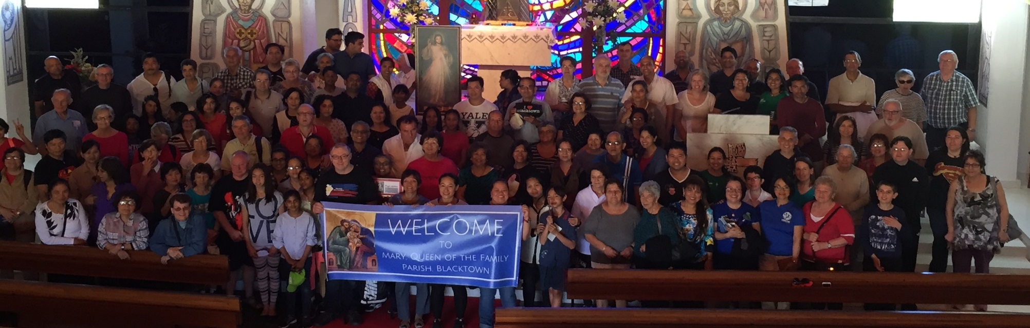
Second Collection
What you contribute now is for the support of our parish and its mission.
Thank you for your contribution
Notes:
<number>

Slide 106
Parish Office Opening Hours in January
9am – 12 pm
Please be careful around St Patrick’s this week due to renovations in Cardinal Clancy Meeting Room.

Slide 107
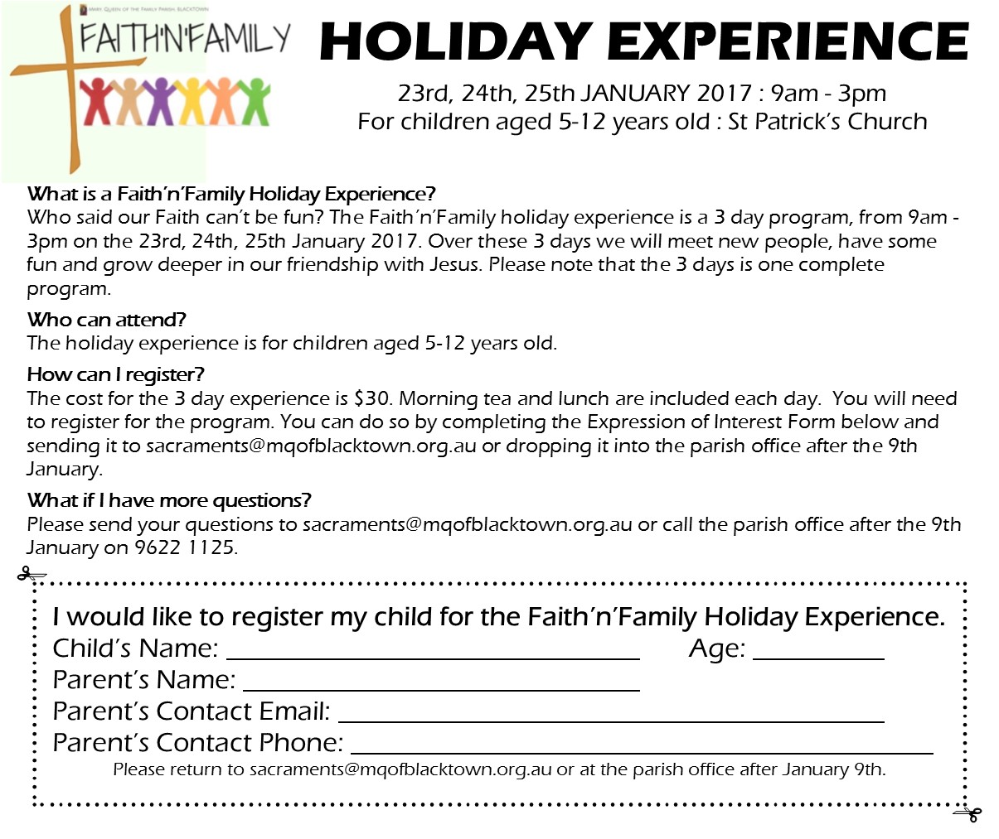

Slide 108

MUSIC : CHILDREN’S LITURGY : READERS OTHER AREAS???

Slide 109
Notes:
<number>

Slide 110
This slide is hidden.
Insert the Recessional Hymns after this slide.
Notes:
<number>

Slide 111
Notes:
<number>

Slide 112
It's no longer I that liveth (Sally Ellis)
It's no longer I that liveth
But Christ that liveth in me
It's no longer I that liveth
But Christ that liveth in me

Slide 113
He lives, he lives
Jesus is alive in me
It's no longer I that liveth
But Christ that liveth in me

Slide 114
It's no longer I that liveth
But Christ that liveth in me
It's no longer I that liveth
But Christ that liveth in me

Slide 115
He lives, he lives
Jesus is alive in me
It's no longer I that liveth
But Christ that liveth in me
“It's no longer I that liveth” words and music by Sally Ellis
© 1980 Kingsway's Thankyou Music
Used by Permission. CCLI License #89350

Slide 116
This slide is hidden.
Insert the final slide here.
Notes:
<number>

